Slide 1
Internet of Things (IoT)
Basic introduction and practical example of IoT

Slide 2
Agenda
What is IoT
Problem that could be solved by the IoT
Limitation of IoT
Practical demo of IoT

Slide 3
Internet of Things (IoT)
What is IoT ?

Slide 4
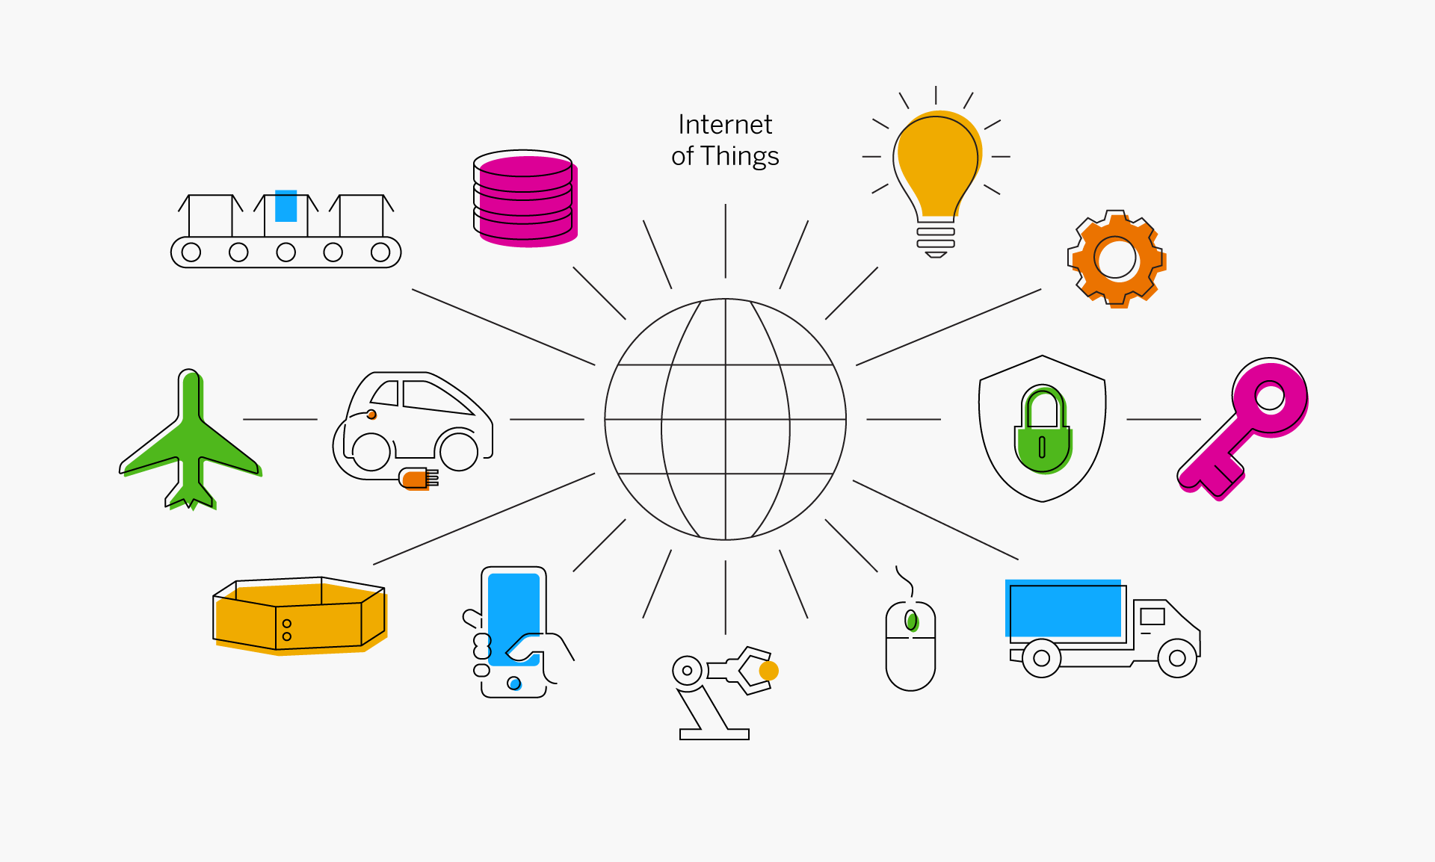

Internet of Things (IoT)
IoT stands for Internet of Things. IoT is a platform where regular device are connected with the internet ,so they can interact , collaborate and exchange data with each other.
Internet
Of
Things

Slide 5



Internet of Things (IoT)
Why do we need to connect real world object(s) to the internet?
Internet
Things

Slide 6
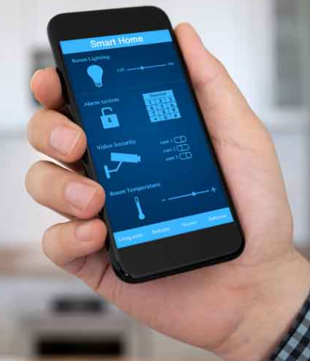


Internet of Things (IoT)
Through Internet we can control or monitor Object status from anywhere in the world.

Slide 7
Internet of Things (IoT)
How will Things/Object connect to the Internet ?

Slide 8
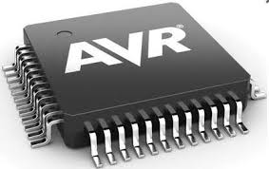
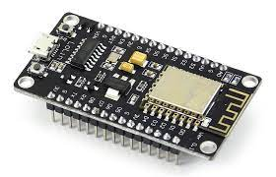
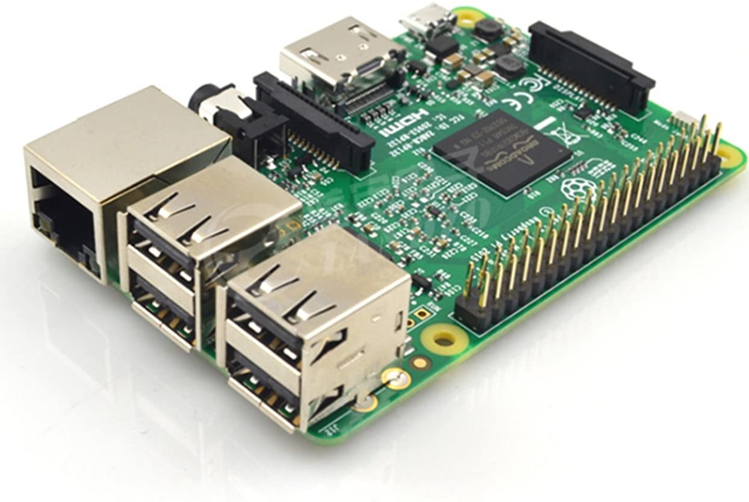
Internet of Things (IoT)
Internet
Things

Slide 9
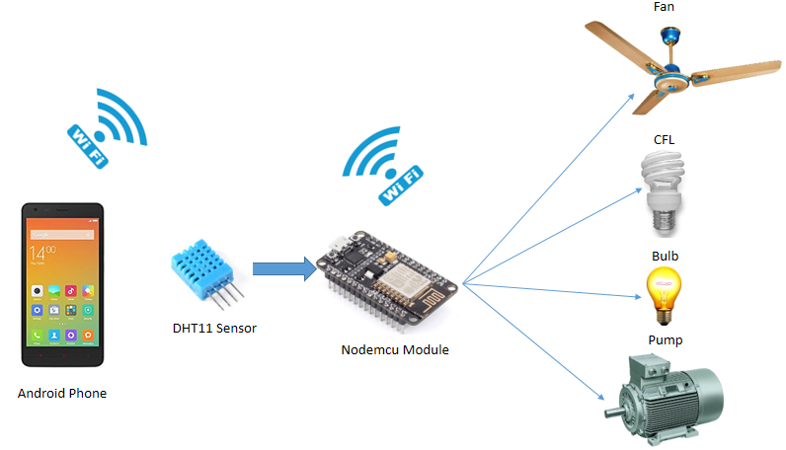
Internet of Things (IoT)

Slide 10
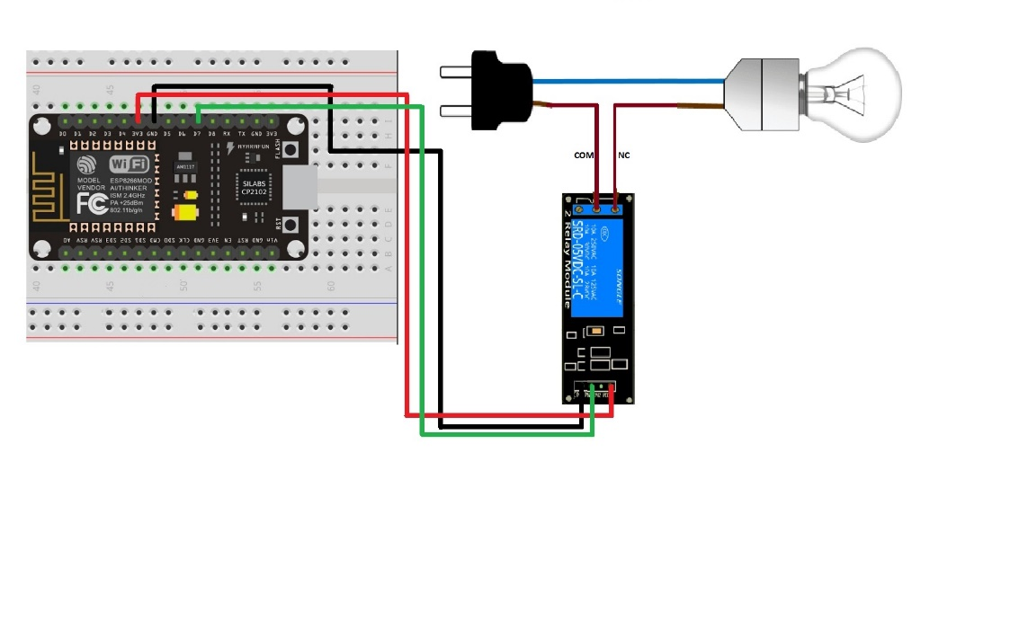
Internet of Things (IoT)

Slide 11
Internet of Things (IoT)
Problem that could be solved by the IoT ?

Slide 12
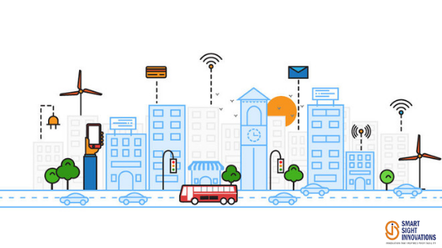
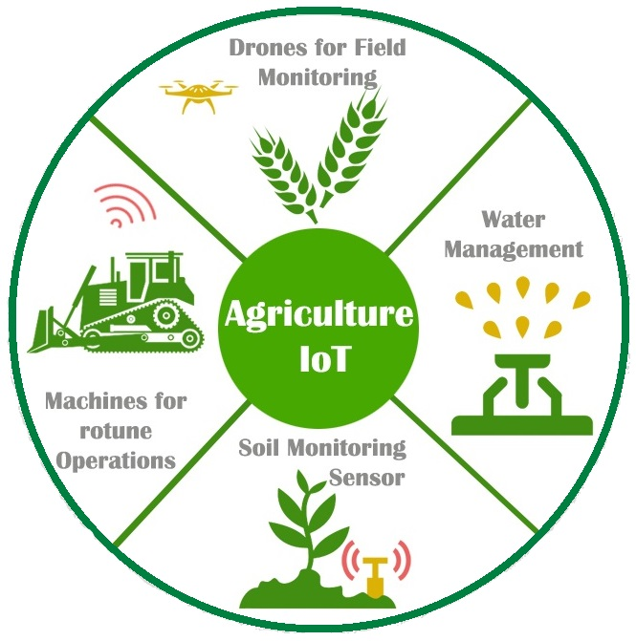
Internet of Things (IoT)
Agriculture
Smart Cities

Slide 13



Internet of Things (IoT)
Limitation of IoT

Slide 14
Internet of Things (IoT)
Practical Demo

Slide 15
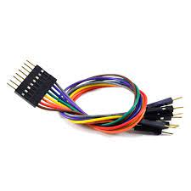
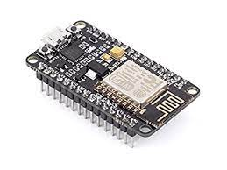


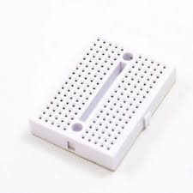
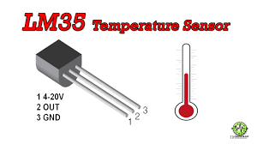


Internet of Things (IoT)
Home Automation & Temperature Monitoring system
Technology used to developing this Project

Slide 16
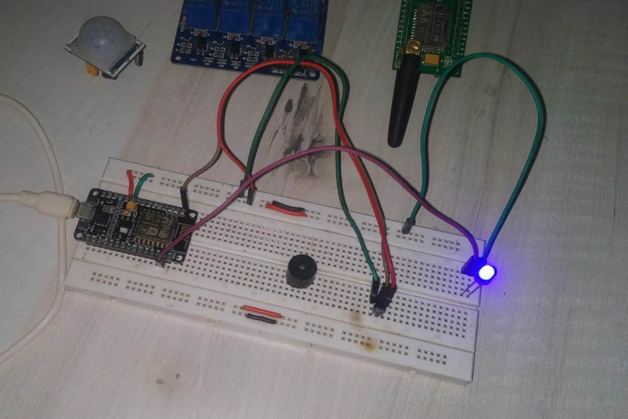
Internet of Things (IoT)

Slide 17
Thank You
Any Question?

